Slide 1

Linux Fundamentals by
Ahmad Khaled Hassanien

Slide 2
Day3 Content
Users and Groups Administration.
File Permissions and Ownership.
Initialization files.
Linux Package Manager (apt).
Linux Processes.

Slide 3
Users and Groups Administration

Slide 4
Users and Groups Administration
A user account is a systematic approach to track and monitor the usage of system resources. Each user account contains two unique identifiers; username and UID.
Types of users:
Root user → uid is 0. Has all privileges
Regular user → uid >=1000
Service accounts → created when packages are
installed

Slide 5
Users and Groups Administration
Managing files and groups are done by those 4 files:
/etc/passwd (7 fields)
username:passwordPlaceHolder:uid:gid:comment:homeDirectory:shell
/etc/gshadow (9 fields)
See next page
/etc/group (4 fields)
gname:password:gid:groupMembers
/etc/gshadow (4 fields)
What is it?

Slide 6
Users and Groups Administration
shadow 9 fields:
Username
Encrypted password
Number of days when password was last changed
Number of days before password can be changed
(minimum password age)
Number of days after password must be changed
(maximum password age)
Number of days before password expiry date to display the warning message
Number of days to disable account after password expiry
Number of days since the account is disabled
Reserved field

Slide 7
Users and Groups Administration
Commands used to modify those files:
useradd
usermod
userdel
chage
passwd
groupadd
groupmod
groupdel

Slide 8
Users and Groups Administration
Examples on the previous commands:
useradd -md homedir -g groupname -s shell -u userid account_name
sudo useradd -md /home/snake -s /bin/bash snake
usermod uses same arguments as useradd plus -l option for
changing user name. ex:
sudo usermod -l solidSnake snake
userdel -r solidSnake
we use -r to delete user home directory and mail if any
passwd is used by root user to set password for a user
passwd snake

Slide 9
Users and Groups Administration
Continue Examples on the previous commands:
chage → use this command to change fileds in /etc/shadow
-l (small L) → view ageing information about account
-d → changes last password change date (-d 2018-12-01)
-E → set when the account expires (-E 2022-12-31)
-M or -m → changes password maximum or minimum age (-M 5)
-W → number of days to give prior warning before the
password expires (-W 2)
-I (capital i) → specify the number of days the account should be
inactive after its expiry (-I 5)
Example: chage -m 5 -W 2 liquid

Slide 10
Users and Groups Administration
Continue Examples on the previous commands:
groupadd developers
groupmod -n new_modified_group_name old_group_name
groupmod -g 545 developer
groupdel developers
Note that to remove a user manually you would have to:
Remove user from /etc/passwd
Remove user from /etc/shadow
Remove user from /etc/group
Remove user’s home directory
Remove user’s mail (/var/spool/mail/user_name)

Slide 11
Users and Groups Administration
We use ‘sudo’ before a command to run commands that require root (admin) privileges.
In order for a user to be able to use sudo, they must be added to /etc/sudoers file.
Don’t edit that file directly. Use ‘visudo’ command as root.
To switch to a different user, we use su command. Ex:
su - [username]
su - ahmed

Slide 12
File Permissions and Ownership

Slide 13
File Permissions and Ownership
Get permissions and owenship:
ls –l: gets file permissions and ownership
example: ls –l myFile
>>> -rw-rw-r-- 1 ahmed ahmed 15 Mar 26 14:42 myFile
ls -ld: gets directory permissions and ownership example: ls –ld myDir
>>> drw-r--r-- 1 ahmed ahmed 10 Mar 26 14:42 myDir

Slide 14
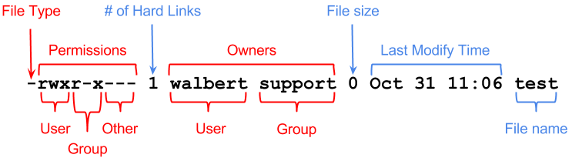
File Permissions and Ownership
r = 4 r stands for read w = 2 w stands for write x = 1 x stands for execute
- Means file d Means directory

Slide 15
File Permissions and Ownership
Change permissions of a file or a directory:
chmod: changes permissions of a file or a directory
example: chmod u=rwx,g=rw,o=r myFile
the same as
chmod 764 myFile
Note:
If you get permission denied while changing permissions, use sudo before chmod. Example:
sudo chmod 764 myFile
Then you will be prompted to enter the root user password

Slide 16
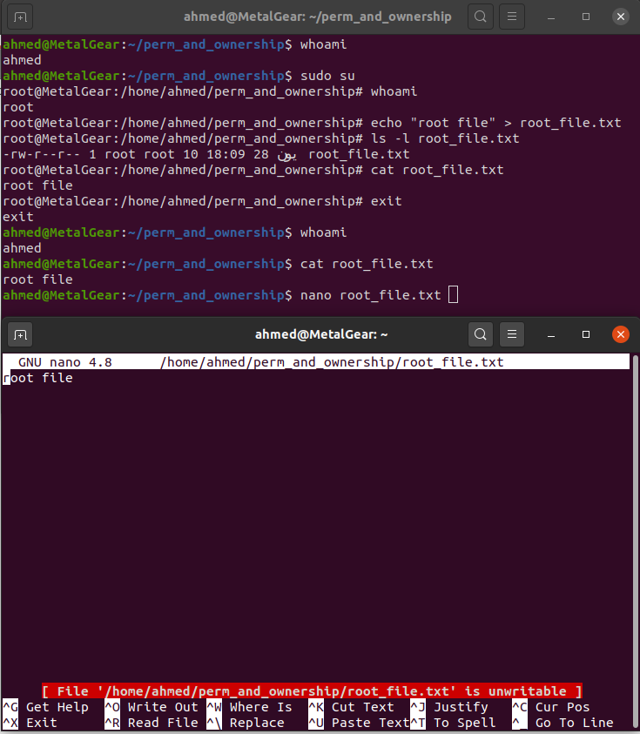
File Permissions and Ownership

Slide 17
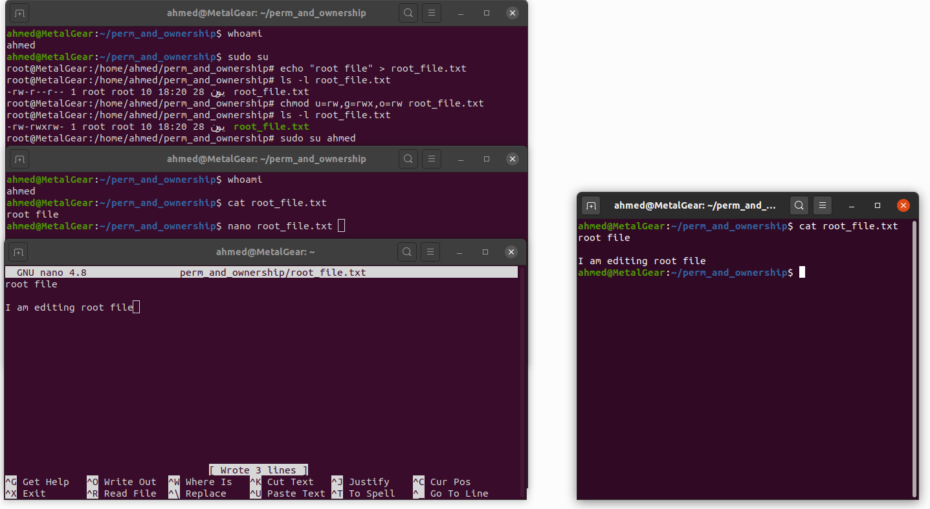
File Permissions and Ownership
After Saving the file

Slide 18
File Permissions and Ownership
Change ownership of a file or a directory:
chown: changes ownership of a file or a directory
example: chown root:ahmed myFile
-> Changes owner and group of myFile
chown root myFile
-> Changes owner only of myFile
chown :ahmed myFile
-> Changes group only of myFile
Note: If you get permission denied while changing ownership, use sudo before chown. Example:
sudo chown ahmed myFile

Slide 19
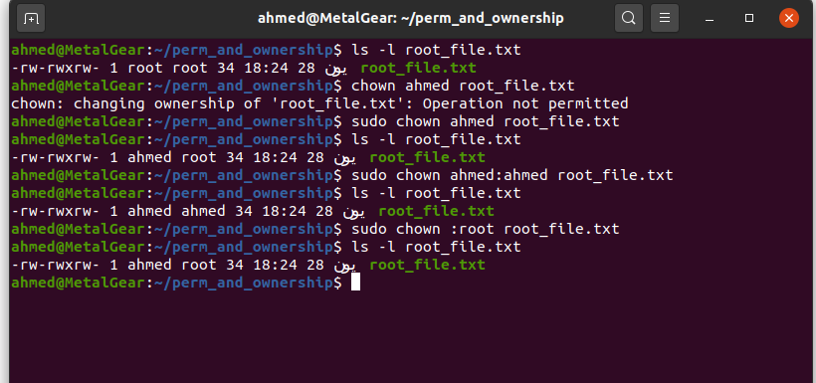
File Permissions and Ownership

Slide 20
Initialization files

Slide 21
Initialization files
When the shell is invoked, there are certain initialization/startup files it reads which help to setup an environment to the shell itself and the system user; that is predefined (and customized) functions, variables, aliases and so on.
There are two types of files:
System-wide config files (Global to all users):
Usually in /etc/profiles or /etc/bashrc or /etc/bash.bashrc
User specific startup files (Affects user only):
Usually in ~/.bashrc or ~/.bash_profile

Slide 22
Linux Package Manager (apt)

Slide 23
Linux Package Manager (apt)
Advanced Package Tool, or APT, is a free-software user interface that works with core libraries to handle the installation and removal of software on Debian, Ubuntu, and related Linux distributions.
Before using apt to install any software, it’s good practice to run ‘sudo apt update” to update the packages repositories (located in /etc/apt).

Slide 24
Linux Package Manager (apt)
To check if a repository exists on your system, use the following command
sudo apt policy PACKAGE_NAME
Example: sudo apt policy git
If a repository is found, you can install the package with the following command: sudo apt install PACKAGE_NAME
Example:
sudo apt install git

Slide 25
Linux Package Manager (apt)
If the package repository does not exist, then we search the web on how to install this package, for example google chrome repository is not added to the Ubuntu official repositories, so we follow a guide online on how to install the google chrome package. See this guide:
https://linuxconfig.org/how-to-install-google-chrome-web-browser-on-ubuntu-20-04-focal-fossa
To upgrade the installed packages to newer versions if any we run two commands:
sudo apt update
sudo apt upgrade

Slide 26
Linux Package Manager (apt)
To remove a package, we run sudo apt remove PACKAGE_NAME
Example:
sudo apt remove git
Note how we use sudo before apt because apt requires root (admin) privileges to run.

Slide 27
Linux Processes

Slide 28
Linux Processes
Whenever a command is issued in Linux, it creates/starts a new process.
A process has an id which consists of up to 5 digits.
There are two types of processes:
Foreground process: must be finished before the user could interact with the terminal again.
Background process: runs in the background which allows user to continue to use the terminal.

Slide 29
Linux Processes
System starts process called “Daemons processes”, which run in the background.
When a process creates another, the first is called a parent process while the created one is called child process.
The first process started by the system is called “systemd”.
All processes are descendant from systemd.

Slide 30
Linux Processes
We use “ps” cmd to list all process.
Syntax: ps [options]
Examples:
ps -ef → lists all runing processes
ps -u uid → lists all user’s processes
We use “top” utility to view processes in real time (like task manager)

Slide 31
Linux Processes
We use “pgrep” to search for a certain process.
Syntax: pgrep [options] [argument]
Some options:
-x → exact match
-u → find processes of specific user
-l (small L) -> display name with pid
Examples:
pgrep -l -x -u 1000 docker

Slide 32
Linux Processes
To run Commands in the background we use “&” after the command.
Syntax: cmd &
Example:
sleep 60 &
To list all background processes we use the “jobs” command.

Slide 33
Linux Processes
To kill (terminate) a process running in the background, we use “kill” or “pkill” command.
We send signals using the above commands. Some signals :
-15 → soft kill (terminate)
-9 → hard kill, use when -15 is not working
-19 → stop a process
-18 → resume a process
Examples:
kill -9 1272
pkill -9 sleep

Slide 34
Thank you Any questions?

